Slide 1
Market integration in the CEE countries
Czech – Austrian trading region
GRI SSE Prag
Alessandro Ischia
07.06.2018

Slide 2




Market integration
First integration idea in the
CEE countries in 2011-
CEETR Project
CZ - AT market integration
2

Slide 3
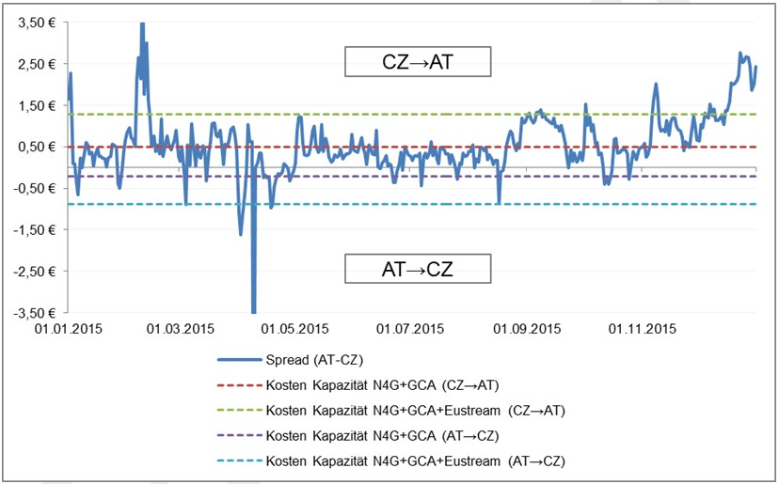
Spread AT-CZ and capacity costs on yearly basis
Source: Wagner Elbling & Comp.

Slide 4
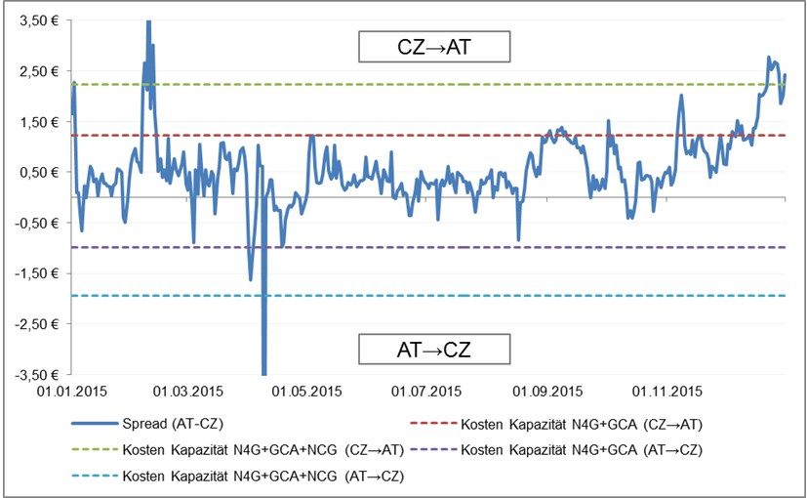
Spread AT-CZ and capacity costs on day-ahead basis
Source: Wagner Elbling & Comp.
4

Slide 5
Czech-Austrian market integration
Joint working group between the involved NRAs (ERÚ and E-Control) and the TSOs (Net4Gas, GCA and TAG) established in 2014
  Various market integration models have been analyzed
    Market connection via new IP Reintal
    Trading Zone with separate VTPs
    Trading Zone with common VTP
    Trading Region Upgrade

Slide 6
Trading Region Upgrade (TRU)
TRU is a HUB to HUB system operators´ service that entitles system users to nominations for exit from the Austrian eastern market area and immediate matching entry into the Czech market area and vice versa
TRU can be bought by shippers and traders

Slide 7


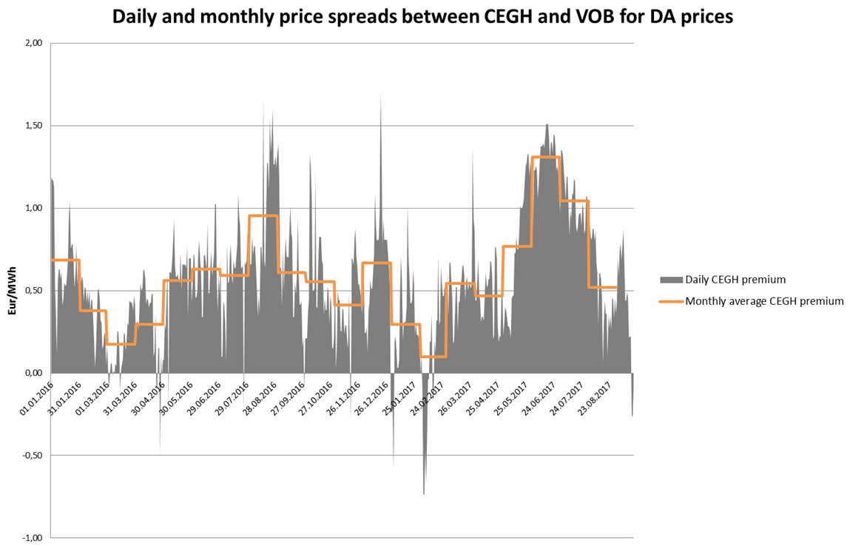

Without TRU
VTP CZ
VTP AT

Slide 8

Trading region upgrade
VTP CZ
VTP AT

Slide 9
Trading region upgrade
VTP CZ
VTP AT

Slide 10
TRU Pilot Phase
Cost of the option:
From VTP Austria to VTP Czech Republic
          7.27 Euro / kWh / h per year (GSNE VO §3 8a)*
From VTP Czech Republic to VTP Austria
          3,6 Euro / kWh / h per year (ERV 7/2017) **
Quantity for 1 year: Up to 10.000 Nm3/h in both directions
Start of the services: 1 October 2018
Services: yearly product
Auction: 2 July 2018 as uniform Price Auction on the web portal of GCA and N4G
* https://www.e-control.at/documents/20903/388512/GSNE-VO+2013+konsolidierte+Fassung+15092017+clean.pdf/6b7011da-7506-bd1d-08b0-a6923fe79248
** http://www.eru.cz/-/energeticky-regulacni-vestnik-7-2017

Slide 11
Alessandro Ischia
810
alessandro.ischia@e-control.at

