Slide 1

UPDATES ON THE LATEST DEVELOPMENTS IN LITHUANIA
Aistija Zubaviciute
Advisor of Electricity Division, NCC, Lithuania
14th Baltic Electricity Market Mini-Forum
21st September, 2012

Slide 2

PRIMARY LEGISLATION
Law on Energy Resources Market (ERM) passed on 22/05/2012:
  Reglamentation of centralized trade of biofuel and oil products, natural gas and supporting instruments from energy prices variation (electricity derivatives)
  ERM organized by BALTPOOL (www.baltpool.lt) and acts as Lithuanian electricity financial market administrator and as Lithuanian gas market operator
  Gas market was launched on 1st March, 2012
  On June 18, 2012 the power exchange operator of Nordic countries Nord Pool Spot AS started administration of Lithuanian power exchange

Slide 3
SECONDARY LEGISLATION (1)
Approved:
  Rules on submission of documentation of TSO ownership unbundling
  Market investigation rules
  Methodology on system services price calculation
  Methodology on power energy price and reserve power service price calculation
  Rules for generators on usage of transmission and distribution networks
  Amendments on:
    Methodology for calculation of the market price
    Methodology for calculation of connection fees (20% for households, 40% for industrials, changing customer status, payment for reduced capacity after 3 years)
    Methodology for calculation of the prices for the renewable energy resouces
    Quality requirements
    Rules on technological, financial and managerial assessment
    Rules on penalties

Slide 4
SECONDARY LEGISLATION (2)
To be approved:
  Amendments of the Methodology for calculation of the prices for the public service obligations (differentiation 2 – MWh and LTL)
  Amendments of the Methodologies for calculation of the prices caps of transmission and distribution services, also public supply and public prices (only for households):
    5 years regulatory period
    WACC application since 2013
    “Profit sharing” mechanism
  Network price caps and other prices for 2013
  Minimum quality levels
  TSO ownership unbundling decision – documents on 30th September
  New RES tariffs for 2013

Slide 5
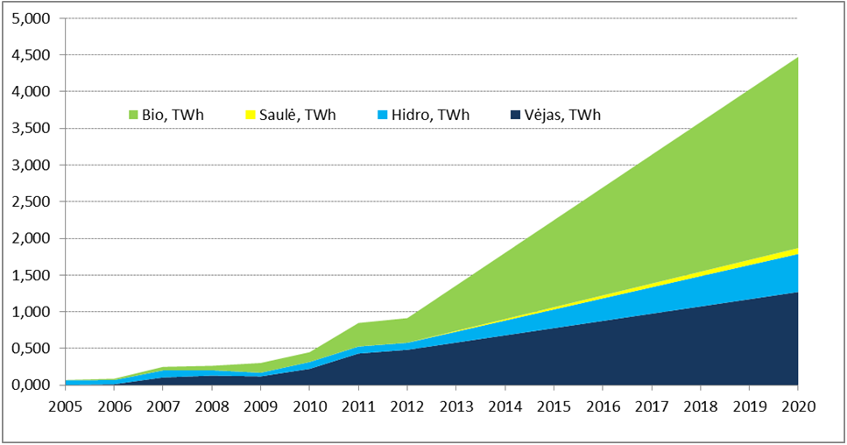
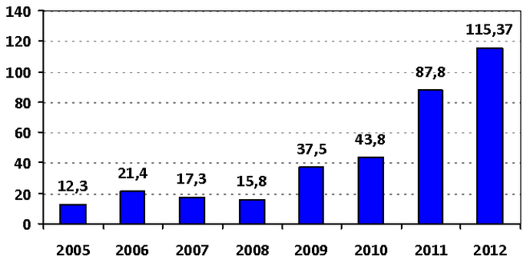
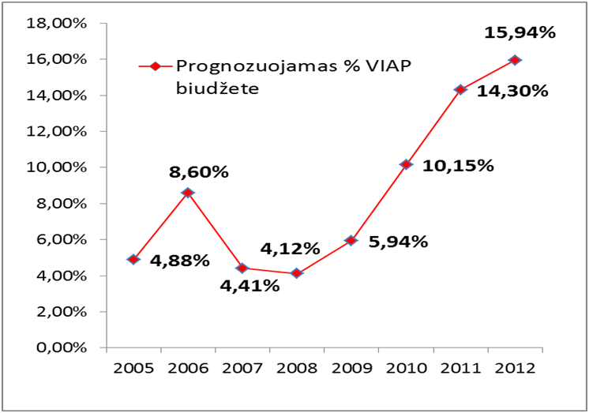
Approved new RES tariffs for 2012

Slide 6
ELECTRICITY MARKET
Nord Pool Spot in Lithuania from 18/06/2012
Prognosis ~60% of electricity consumption (2012 – 30 kW) - no end-user price
From January 1st of 2013 all consumers, except households
Currently 26 active IS of 65 licensed IS
Concentration remains high

Slide 7
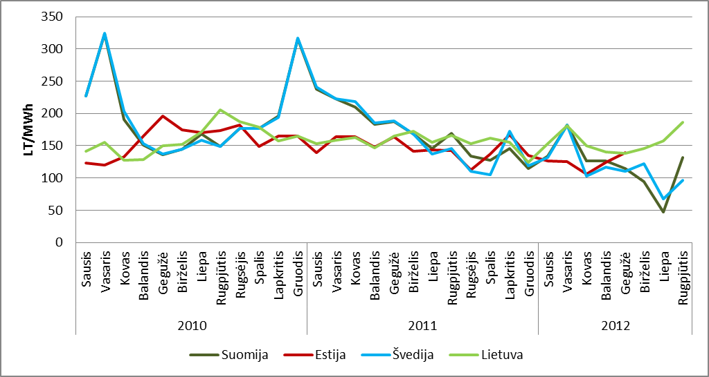
PEX PRICE IN 2011- Aug 2012
www.baltpool.lt and www.nordpoolspot.com

Slide 8
MARKET DEVELOPMENT
Projects of common interest:
  LitPol Link 1
  LitPol Link 2
  Connection of new NPP
Visagino NPP – referendum
RES integration
Smart metering: cost-benefit analysis submission to EC
TSO benchmarking
Regional issues

Slide 9
THANK YOU FOR YOUR ATTENTION
www.regula.lt

