Slide 1
Unintended cross-border electricity flows in Central Eastern Europe and their regulatory implications
Jacek RATZ
jacek.ratz@pse-operator.pl
14th Baltic Electricity Market Mini-Forum
Friday, 21 September 2012
Riga, Latvia

Slide 2
Outline of the presentation
Problem of unplanned power flows in CEE
Countermeasures
Regulatory implications

Slide 3
Unplanned power flows in CEE
3

Slide 4
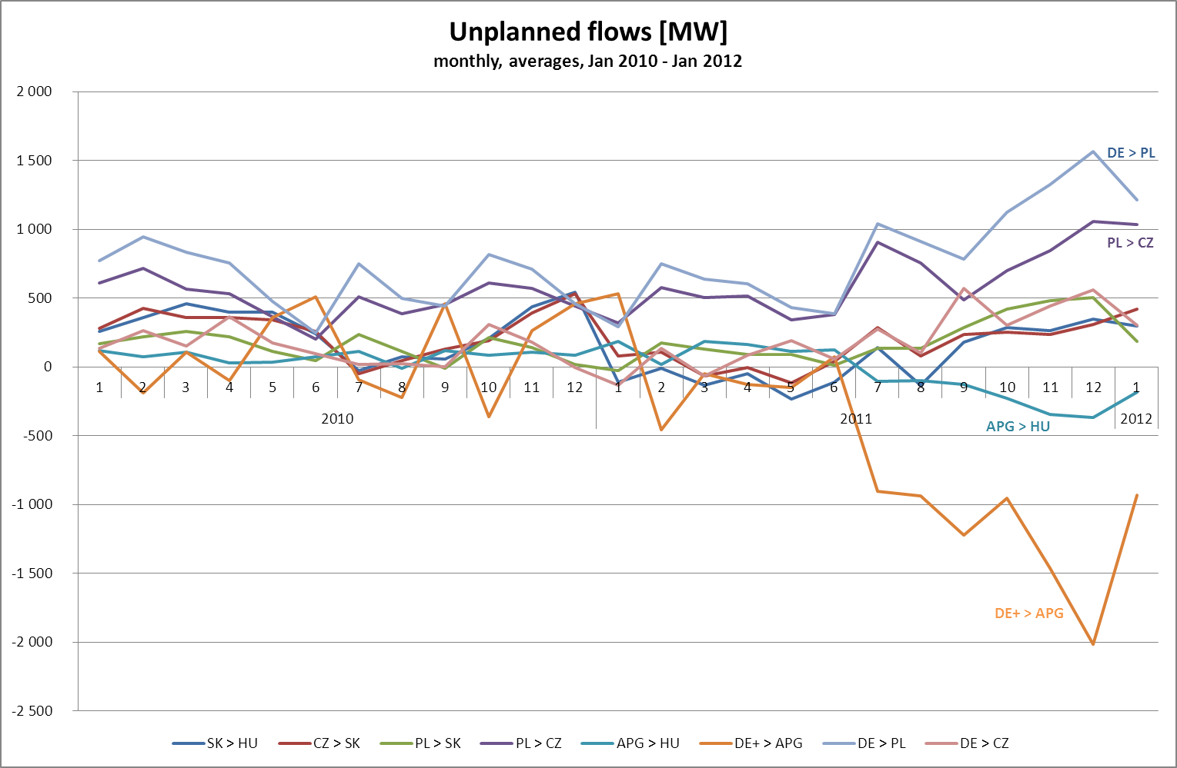
in CEE region

Slide 5
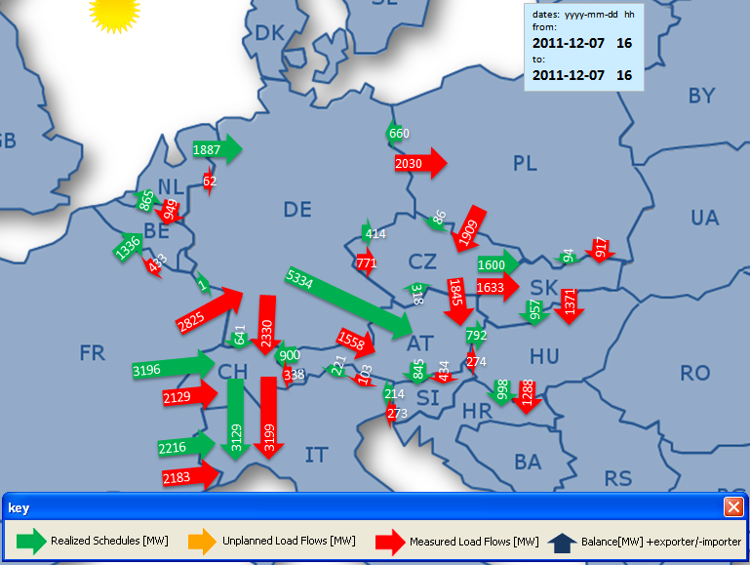
Comparison of commercial schedules and physical power flows
on the borders of national transmission systems
Commercial schedules
Critical conditions
7 December 2011
ca. 16:00
Physical power flows
5 334 MW of cross-border exchange scheduled on Germany – Austria border
Actual power flows on this interconnection amounted to only 1 558 MW
As a result, unplanned flow through the Polish network reached some 2 700 MW
5

Slide 6
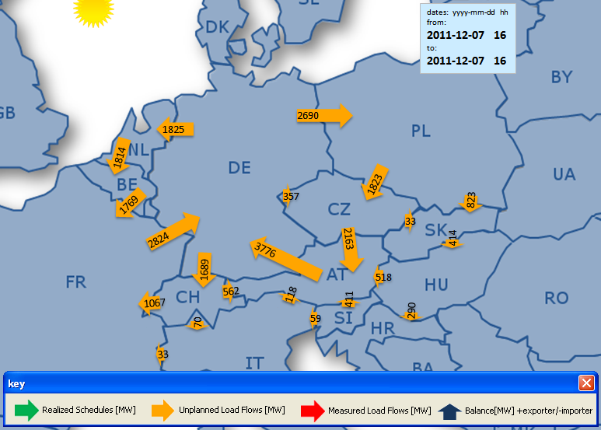
Maximal unplanned power flows Germany - Poland 7.12.2011
transits schedules
Critical conditions
7 December 2011
ca. 16:00
5 334 MW of cross-border exchange scheduled on Germany – Austria border
Actual power flows on this interconnection amounted to only 1 558 MW
As a result, unplanned flow through the Polish network reached some 2 700 MW
6

Slide 7
Unplanned power flows
Unplanned power flows/unintended cross-border electricity flows = physical flows – scheduled flows
Unplanned power flows results from
  „loop flows” (consequence of physics)-power flows that are caused by internal transactions within bidding areas
  „transits/parallel flows”- consequence of commercial transactions between bidding areas
Natural consequence of zonal market design in Europe
Cannot be totally eliminated
Decrease cross-border capacities available for the market
May threaten security of operation

Slide 8
Unplanned transits due to internal transactions
PROBLEM:
Internal transactions cause power flows via other bidding areas
SOLUTION:
Cannot be tackled in zonal
However, it can be limited by proper zones
8
Notes:
8

Slide 9
Unplanned transits due to trade between bidding areas
PROBLEM:
Transactions between two bidding areas cause power flows in other areas
SOLUTION:
Can be tackled with FBA…
… if bidding areas are well defined
9
Notes:
9

Slide 10
Unplanned transits due to trade between bidding areas in another region
PROBLEM:
Cross-border transactions in another region cause power flows
SOLUTION:
Coordinate cross-border capacity allocation in the whole synchr. grid
But, it must be FBA
10
Notes:
10

Slide 11
The issue of unplanned power flows
Unplanned power flows are a material threat for the CEE power systems
  Unplanned power flows are not controlled by market based capacity allocation mechanisms
  Even with very low transfer offered capacities, there are still N-1 violations
  Unplanned flows on particular borders of up to several hundreds MWs

Slide 12
Increasing occurrence and duration of security threats to the Polish Power System asking for extraordinary remedial measures

Slide 13
Notes:
Pokazanie częstości wykorzystywania środków zaradczych

Slide 14
The issue of unplanned power flows
Unplanned power flows reduce market efficiency
  Even with very low transfer offered capacities, there are still N-1 violations
  Unplanned flows are not controlled by the market mechanism
  Yet, these flows always take away transfer capacity from the market
  This can lead to reduced capacities and social welfare, distorting price signals
14

Slide 15
Share of allocated capacities
compared to physical flows [%]

Slide 16
Countermeasures against unplanned power flows
16

Slide 17
POSSIBLE SOLUTIONS:
What can be done to alleviate the problem of unplanned flows?
Close the gap between market design and physics
  Improve the current market design
    Ensure that transactions concluded by market participants are technically feasible
  Flow-Based Allocation with correctly defined Bidding Zones
    Transactions within Bidding Zones should have no or little impact on power flows outside
    Trade opportunity is ensured by market coupling and financial hedging instruments
Make the physical network conditions insensitive to market decisions
  Build lots of transmission lines to make the grid a copper plate
    This is a long term process, costly, and probably not affordable
  Make the power system more flexible
    Power flows control devices (phase-shifters, DC connections, etc)
17

Slide 18
Short and long term measures against unplanned flows
Short term measures
  Related to cross-border remedial actions
    Ensure their availability – currently available measures often already exhausted!
  Related to market design changes
    Flow-Based Allocation
    Correct definition of bidding zones
Long term measures
  Enhance grid flexibility
    Flow control devises (phase-shifting transformers), used in a coordinated manner
  Build more transmission lines
    To support the „quality” of Bidding Zones
    To support interconnectivity between Bidding Zones
18

Slide 19
Three main activities in order to decrease unplanned power flows
19
In order to effectively tackle unplanned power flows, PSE Operator, 50HzT, ČEPS, SEPS, and MAVIR are enhancing their cooperation at bilateral, regional and European levels in activities covering the following areas
  System development
  Market integration
  Operational grid security

Slide 20
System development
Phase Shifting Transformers on the borders DE-PL and DE-CZ
What is to be done?
Double circuit 220 kV line Krajnik-Vierraden to be switched to 400 kV
2 PSTs on 400 kV double circuit line Krajnik-Vieraden
2 PSTs on 400 kV double circuit line Mikułowa-Hagenwerder
2 PSTs on 400 kV double circuit line Hradec-Roehrsdorf
Expected benefits
better management of unplanned flows between Germany, Poland and Czech Republic
enhanced transfer capacity on Polish synchronous profile. Estimated NTC increase:
  500 MW for import and 1500 MW for export
greater security of the regional transmission network in Poland and in other countries of the CEE region
increased capability to accommodate more renewable energy resources in a safe and reliable manner, both in Poland and Germany
20

Slide 21
System development
3rd interconnection to Germany
What is considered
  400 kV double circuit line Plewiska-Eisenhuettenstadt
Expected benefits
  strengthening market integration between member states
  increasing NTC by 1500 MW for import and 500 MW for export
  on PL-DE/SK/CZ synchronous profile
  improving network security - project contributes to increase of security of supply and flexibility of the transmission network
21

Slide 22
Market Integration
FBA MC as the Target Model 2014/2015
  PSE Operator fully supports FB MC as the target model to be implemented by end of 2014, in line with European Council decision
  PSE Operator recognizes the challenges associated with this target
    CEE region should implement FBA MC by end of 2013
    FBA method should offer „positive benefits for each country”
    This tight deadline might mean that 2013 FBA MC will not offer substantial benefits to tackle the issue of unplanned power flows as bidding zones will most likely remain unchanged
    Progress on this item will come either after implementation of Network Code Capacity Allocation and Congestion Management (2015-2018) or after installing PST (later than 2015)
    ENTSO-E proposal to start early implementation of NC CACM is welcome
22
Notes:
Kontekst: Decyzja polityczna Rady Europy podjęta w lutym 2011 – reforma rynku ma być zakończona do końca 2014r. Target Model to FBA Market Coupling
Deklaracja Rady Europy jest oczywiście bardzo high level - nie mówi nic o FBA lub ATC. Ogólna interpretacja jest taka, że Rada Europey wymaga implementacji Market Coupling. Dodatkowo, wymaganiem TSO jest że europejski Market Coupling ma funkcjonować na bazie FBA.
Działania na poziomie Europy:
Projekt NWE – implementacja wspólnego Market Coupling (na bazie ATC) w połączonych regionach CWE i krajach skandynawskich. Obecnie te kraje mają już swoje osobne mechanizmy ATC-Market-Coupling, ale chodzi o to aby był to jeden wspólny proces NWE market coupling.
Projekt CWE FBA – przejście w regionie CWE (część regionu NWE) na FBA do wyznaczania zdoności
Projekt CEE FBA MC – implementacja w regionie CEE mechanizmu Market Coupling, z jednoczesnym dołączeniem się do NWE market coupling, oraz przejściu na FBA.
Projekt CEE FBA MC toczy się lecz raczej w ślimaczym tempie i przy ciągłych dyskusjach i problemach
Część projektu CEE związana z Market Coupling jest znacznie łatwiejsza – nikt nie kwestionuje zasadności, dyskusje jedynie co sposobu przeprowadzenia tego procesu i relacjach pomiędzy poszczególnymi podmiotami – normalne dyskusje biznesowe
Część projektu CEE związana z FBA to niekończące się dyskusje o FBA, strefach i przepływach nieplanowych
Projekt CEE jest silnie uzależniony od CWE, tzn CWE wielokrotnie wspominali że rozszerzenie Market Coupling na region CEE jest możliwe tylko w konfiguracji FBA. Jeśli CWE nie zaimplementuje FBA, połączenie CEE i CWE może nie być oczywiste.

Slide 23
Market Integration
FBA MC offers benefits to CEE countries (1)
  Even though 2013 FBA foresees a large DE-AU bidding zone, PSE Operator sees benefits in coordinating cross-border transactions
    FBA MC will account for different cross-border capacities available under various export/import positions of the CEE countries
    FBA MC will not allow Austria to export energy in uncoordinated way,
    i.e. towards the Balcans
      Austria is able to consume internally only a limited amount of energy from Germany
      Austria cannot internally accommodate import of 5000-6000 MWW
    Any export from Austria will be limited by bottlenecks in DE-PL and DE-CZ
      Austria does not exist for FBA MC – it will be Germany + Austria (= Germany)
23
Notes:
Stanowisko PSE Operator – dla nas FBA daje korzyści mimo że nie jest optymalne przy utrzymaniu strefy DE-AU – tak jak napisane na slajdzie.
Tu staramy się przekonać Czechów do nie odrzucania FBA

Slide 24
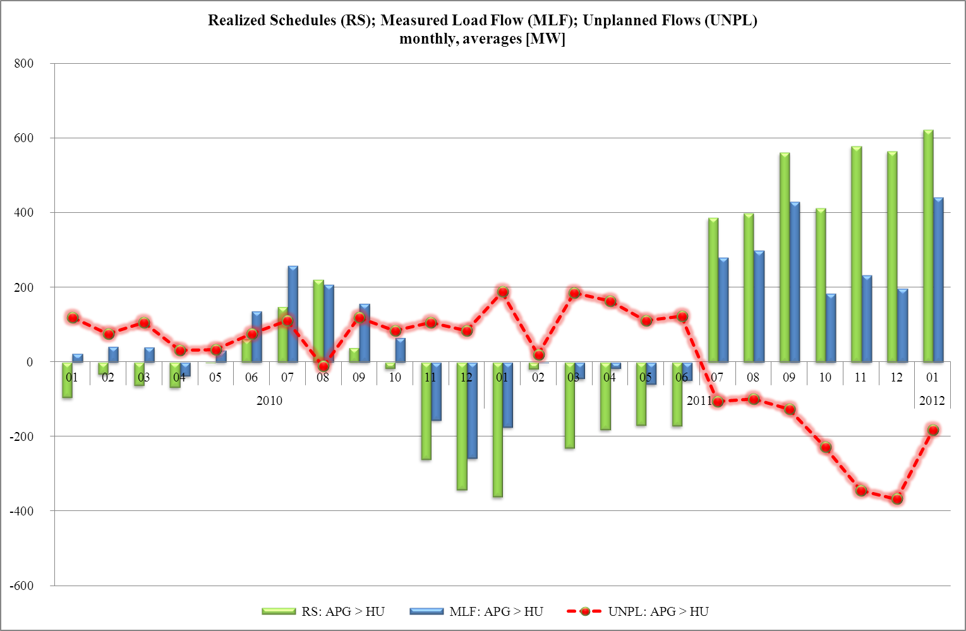
DE-AU
2010 – 2011
AU-HU
2010 – 2011
24
Notes:
Pokazujemy że największe problemu sieciowe z przepływami nieplanowymi które miały miejsce w 2011 wynikały z eksportowania niemieckiej energii z Austrii przez Węgry dalej na Bałkany.
FBA nawet ze strefa DE-AU by na to nie zezwoliło

Slide 25
Market Integration
  Currently, CEE FB MC project is going slowly and painfully
    The project is not really pushed forward by all parties
    Reluctance from CEE countries that are confronted with unplanned power flows as FB MC is viewed as a step towards preserving DE-AU bidding zones
    No real belief that 2013 target will be reached („positive benefits for all countries”)
  Optimal short term actions
    Acknowledgement of the impact of DE-AU transactions on CEE region
    Fine-tuning of FBA method to account for the above
    Decision on long-term solution taken already NOW
    Start of the early NC CCM implementation process (including bidding zones review)
25
Notes:
Tu proponujemy przeprowadzenie wspólnie z CEPS analizy wpływu obszaru DE-AU na CEE FBA. Potrzebujemy tej wiedzy, oraz przyznania innych OSP co do faktycznej skali wpływu transakcji DE-AU na nasze sieci.
Nigdy nie udało nam się takiej analizy uzgodnić i wykonać w ramach CEE HLM (brak zgody i rozmywanie tematy przez DE-AU), więc powinniśmy nauczeni tym doświadczeniem wykonać je sami. Nasza poprzednia inicjatywa wspólnego raportu CEPS-PSEO-MAVIR-SEPS była sukcesem.
Inna sprawa to możliwości poszukania sposoby wprowadzenie zmian w mechanizmie FBA tak aby wpływ transakcji DE-AU nie zabił efektywności CEE FBA (lub po prostu mechanizmu kompensacji za przepływy nieplanowe)

Slide 26
Market Integration
  CEE-NWE MC launch date is far and uncertain: Should PSE Operator and ČEPS propose and push for an alternative solution? Meanwhile, would PSE Operator like to join CZ-SK-HU MC as a preparatory step?
  Foreseen analyses of unplanned flows are not likely to deliver conclusions soon. Should PSE Operator and ČEPS initiate and carry out their own analysis(es) – e.g. beginning with performing a transparent analysis of impact of DE-AT bidding zone on CEE FB MC - without further delay?
26

Slide 27
Operational Grid Security
TSC: Future plans of the TSC initiative
  TSC initiative is analyzing its current activities
    What is TSC currently doing as compared to what needs to be done?
    Future role of TSC in the context of European Target Model
    Relations to ENTSO-E, CORESO, CAO, CASC
  New TSC Working Groups launched
    Prepare new TSC business model (convened by TENNET NL)
      Investigate future models for TSC – centralized, decentralized, lean structure, etc
    D-2 Common Grid Model and Capacity Calculation (convened by PSE-O)
      What needs to be done to establish a common CGM building function and CapCalc
      What are the synergies between the current DACF and D-2 CF processes
      Intra Day DACF and Intra Day Capacity Calculation
27

Slide 28
Operational countermeasures
Bilateral operational cooperation with 50HzT intensified accordingly:
  list of remedial actions to relieve border congestions developed including:
  HVDC rescheduling (DC loop flow) together with EnDK and SvK in 2008 (first of a kind multilateral countermeasure),
  cross border redispatching in 2008 (with 50/50 cost sharing principle – first on the Continent),
Once exhausted bilateral cooperation turned into regional one (TSC project launched in 2009) with ongoing challenges:
  common operational planning process (DA & ID),
  multilateral redispatching (missing cost sharing key),
The above reported timely in relevant CEE and UCTE/RGCE operational working groups.

Slide 29
Curative actions on PSEO – 50HzT profile
    opening the 220 kV bus coupler in Passewalk (50HzT)
    use of angle regulated transformers in Neuenhagen (50HzT)
    use of angle regulated transformers in Mikulowa
    rescheduling of HVDC links (DC loop flow)
    countertrading on 50HzT side (decreasing exports)
    internal redispatch within 50HzT and PSEO control areas
    opening the 220 kV bus coupler in Świebodzice (local n-1 endangered)
    cross – border redispatching (might be multilateral – TSC)
    reconfiguration in 400 kV grid in Lower Silesia: two nodes in Dobrzen and switching off line Pasikurowice – Ostrow (local n-1 not fulfilled)
    decreasing of renewable power in 50HzT control area (for cross border redispatching)
    switching off tie line Krajnik -Vierraden as a very last resort
    green – grid related; blue - market related; red – emergency

Slide 30
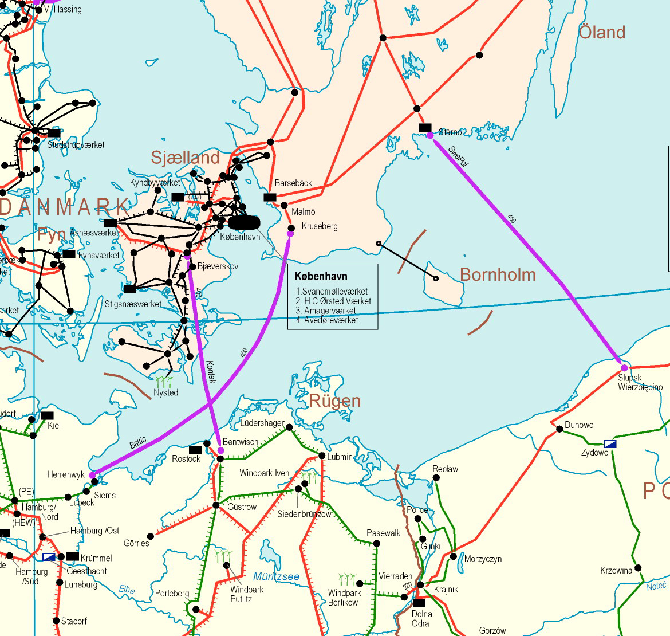





HVDC rescheduling (DC loop flow)
SwePol Link
Kontek

Slide 31
Subject of the measure
Simultaneous change of schedules on two HVDC links in opposite directions,
Accompanied by changes on AC profiles,
Result: moving power in a closed loop:
  relieving congestion on AC profiles,
No need for changes of any generation output:
  no cost measure,
Preconditions:
  free capacity on the HVDC links (& AC profiles) – no influence for market players,
  possibility of schedule changes between TSOs overlying market outcome – limiting for Baltic Cable.

Slide 32
Monthly volumes of HVDC rescheduling on 50HzT and PSEO requests

Slide 33
Topological
measures
  opening 220 kV bus coupler in Świebodzice
  reconfiguration in Dobrzen: two 400 kV nodes
  switching off 400 kV line Pasikurowice – Ostrów
  opening 220 kV bus coupler in Kopanina (decreases loading of congested 220 kV line to CEPS) used as a countermeasure on PSEO – CEPS profile.
3
1
2
4

Slide 34
Internal PSEO topological measures due to transit/loop flows – monthly time of use
Ostrów
Kopanina
Dobrzeń
Świebodzice

Slide 35
Cross-border redispatching PSEO->50HzT

Slide 36
Regulatory implications of unplanned power flows
36

Slide 37
Changing situation in Europe (1)
Main factors
Increasing capacity of RES → Changing pattern of generation
Increasing volume of cross-border exchanges that may cause large-scale transmission of electric power across regions where the unexpected power flows may push electricity networks towards their physical limits.
  Increasing volume of short term trades (day ahead and intraday)
  Less predictable and fast changing power flows
Environmental concerns and policies that prevent construction of new generation and transmission lines.
Constraints of investment costs
  Insufficient system development
37

Slide 38
Changing situation in Europe (2)
Unplanned power flows are the example of problem affecting a growing number of TSO
Such problems cannot be solved by one or two TSO
  Usually the problems within one TSO control areas are caused by activities in another TSO control area
Solving of such problems needs close cooperation of more TSOs
Current legislation do not facilitate this process
There is a need for support from regulators
38

Slide 39
Changing situation in Europe (3)
  Current solutions
Better coordination of operation and cooperation of TSOs
    ENTSO-E, CORESO, TSC, CASC, CAO
    D-2 Common Grid Model: Enlarge geographical area for D-2CF model
    D-2 Capacity Calculation: - Flow Base Capacity Calculation
    - Capacities to be calculated in a largest geographical area
    possible
    D-1 Congestion Forecast: - Improve quality of the process by aligning TSO processes
Implementation of Network Codes
    Flow-based market coupling, coordinated intra day and balancing
Future solutions?
39

Slide 40

Thank you for your attention!
Questions?

