Slide 2
Agenda

Slide 3
Housekeeping
Post your questions and comments in the chat box, optionally indicating your affiliation
Substance-related questions will be moved to the Q&A session; minor queries will be tackled in the chat
Keep your microphone muted unless the chair gives you the floor
Slides from this webinar will be uploaded to ACER website
Questions and comments will be addressed in the Q&A session at the end of the webinar

Slide 4
Process for submitting responses to the public consultation and timeline for amendments
ACER

Slide 5
Process for submitting responses to the PC
Stakeholders are invited to submit their comments to the NC RfG and NC DC articles amended by ACER in three mandatory steps:
STEP 1: by downloading the ACER draft amendments in the Word file provided in the consultation form;
STEP 2: by commenting on the ACER's draft amendments through the consultation form and adding alternative text proposals to the table, if any; and
STEP 3: by uploading the alterative amendment proposals to the entire NC RfG and NC DC using the Track Changes mode in the ACER draft amendments file downloaded from Step 1.

Slide 6
Process for submitting responses to the PC
Kindly note that consultation forms follow the structure of the NC RfG and NC DC amended legal texts provided by ACER. The paragraph numbering in the form reflects paragraph numbers in the amended legal text. Stakeholders can comment on the deleted paragraphs/articles/titles, which are marked as [deleted]. New articles and titles are marked as [new].
Please use the consultation form to comment on ACER draft amendments and/or to provide an alternative text proposal as follows:
1. Leave comments on the ACER draft amendment proposals. 2. Propose (if any) alternative wording of the relevant provision, as you provided in the Word file. 3. Provide (if any) your proposals for adding new provisions to the relevant section of the NC RfG and NC DC, as you provided in the Word file. 4. Upload figures or tables if necessary; text inputs should be provided directly in the consultation form.
Where the stakeholder does not have any comments regarding the amendments, the relevant cells in the consultation form can be left blank.

Slide 7
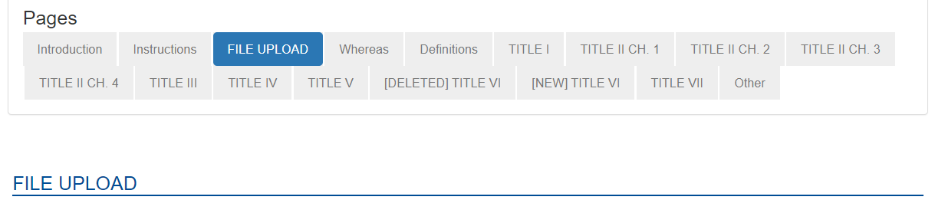
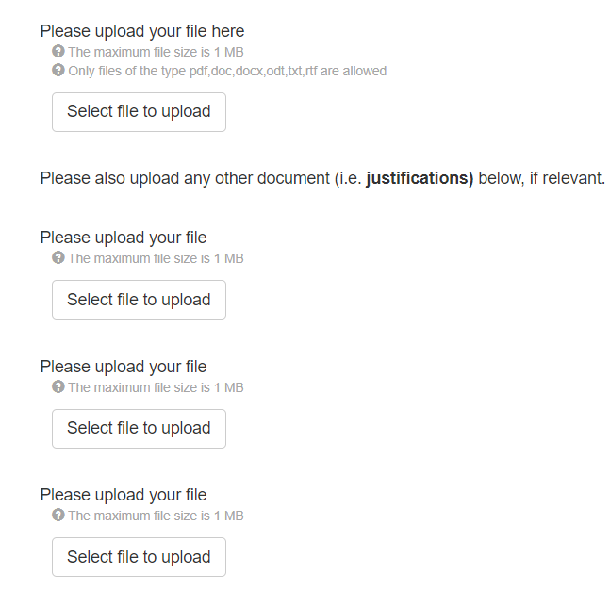
Process for submitting responses to the PC
Where the stakeholder would like to propose an alternative amendment to the entire NC RfG or NC DC, please upload the Word file (downloaded from Step 1) containing all your alternative amendment proposals in the Track Changes mode to the FILE UPLOAD section and rename it with your stakeholder's name ("ACER_draft_RfG_stakeholder_name“ or "ACER_draft_DC_stakeholder_name").
Additional justification documents could also be uploaded, where applicable.
To facilitate the process, please, make sure that the alternative text proposals provided in this consultation form are consistent, to the extent possible, with those in the Word file you are uploading, taking into account the character limitations of each cell (max 5000 characters).

Slide 8
CNC - amendment process
Scoping phase – Policy Paper
Q1-Q2 2022
Public Workshop
Public consultation
Stakeholders to submit their proposals
September 2022
8+1 weeks
Public Workshop
ACER proposals for amendments
Q1 & Q2 2023
SOGC TF drafting (ETs)
Public Consultation on ACER proposal
Finalisation of amendments & recommendation
Decision phase
BoR approval
Submission to EC
Mid-July 2023
10 weeks
Public Webinar
Late Q3 2023
Recommendation drafting
Finalisation of amendments
Public consultation in June
Q4 2023
BoR FO
Q4 2023
3 dedicated public workshops

Slide 9
Concluded ACER Public Workshops
17 April 2023 – electromobility, power-to-gas demand units and heat-pumps
10 May 2023 – rate of change of frequency (RoCoF) and grid forming capabilities
11 May 2023 – technical requirements for electricity storage
Materials from ACER Public Workshops:
https://acer.europa.eu/news-and-events/news/registration-open-acers-3-workshops-related-electricity-grid-connection-network-codes

Slide 10
Public consultation on ACER draft proposal
ACER proposals for amendments
Public Consultation on ACER proposal
10-week long public consultation
Launched on 17 July, end on 25 September 2023
Stakeholders to comment on ACER draft amendment proposals
Q1 &Q2 2023
Mid-July 2023
SOGC TF drafting (ETs)
10 weeks
Public Webinar
3 dedicated public workshops
NC RfG
NC DC

Slide 11
Proposed amendments to the grid connection network codes
ACER

Slide 12
ACER draft proposals for NC RfG amendment

Slide 13
Selected new recitals
Clarifying the notion of SPGMs
“An installation containing a set of synchronous machines that cannot be operated independently from each other, such as combined-cycle gas turbine installation, should be assessed on the whole capacity of that installation.”
Introducing the notion of integrated energy storage
“Electricity storage integrated to a power-generating module, where module is either non-synchronously connected to the network or connected through power electronics, used solely for the purpose of meeting the requirements of this Regulation should be considered as part of such module while its capacity should not count towards the power-generating module capacity.”
Capturing autonomous energy islands
“Power-generating modules are subject to the requirements of this Regulation regardless of whether they are part of an energy community as defined in Regulation (EU) 2019/943, another entity, or a form of system users aggregation, unless such energy community, another entity, or a form of system users aggregation constitutes a fully autonomous energy island.”

Slide 14
Electromobility – applicability of GC NCs
New definitions (non-exhaustive list)
'V1G electric vehicle' means the vehicle that is powered, fully or in part, with electricity and can only withdraw electricity from the grid.
'V2G electric vehicle' means the vehicle that is powered, fully or in part, with electricity and is equipped with technology enabling the vehicle to provide electricity to the grid.
'Electric vehicle supply equipment' means the infrastructure necessary to safely conduct electrical energy between the electricity supply grid and the electric vehicle. Electrical wirings are not deemed part of an electric vehicle supply equipment.
‘Electrical charging park’ means the installation that has a single connection point to the relevant network and where one or more electric vehicles can be simultaneously connected.

Slide 15
Electromobility – applicability of NC RfG
0,8 kW ≤ capacity < 2,4 kW
V2G type EV1
2,4 kW ≤ capacity ≤ 42 kW
V2G type EV2
42 kW < capacity < 1 MW
V2G type EV3
Bidirectional electric vehicles and associated bidirectional electric vehicle supply equipment
Article 13a of NC RfG
– exhaustive requirements (same for both EV1 and EV2)
Article 14a of NC RfG
requirements applicable to type EV1 and EV2
voltage ranges for MV/HV/EHV
system management
reactive power capabilities
post-fault active power recovery
grid forming capabilities
frequency and voltage (LV) ranges
RoCoF withstand capability
data interface for charging infrastructure
autonomous connection / reconnection
LFSM-U EV and LFSM-O EV
voltage robustness/FRT

Slide 16
Electromobility – applicability of NC RfG
0,8 kW ≤ capacity < 2,4 kW
V2G type EV1
2,4 kW ≤ capacity ≤ 42 kW
V2G type EV2
42 kW < capacity < 1 MW
V2G type EV3
Bidirectional electric vehicles and associated bidirectional electric vehicle supply equipment
1 MW
Beyond 1 MW, EV and associated supply equipment are regarded as electricity storage module (ESM)
Article 13a of NC RfG
– exhaustive requirements (same for both EV1 and EV2)
Article 14a of NC RfG
requirements applicable to type EV1 and EV2
voltage ranges for MV/HV/EHV
system management
reactive power capabilities
post-fault active power recovery
(grid forming capabilities)
frequency and voltage (LV) ranges
RoCoF withstand capability
data interface for charging infrastructure
autonomous connection
LFSM-U EV and LFSM-O EV
voltage robustness/FRT

Slide 17
Application of technical requirements
Examples of aggregation and application of technical requirements
1
4
5
EV1
V2G electrical charging park
Pmax = 2 kW
EV 3
EV 2
2
EV2
EV 3
V2G electrical charging park
EV 3
CP
CP
Pmax = 2.4 kW
V2G electrical charging park
3
EV3
EV 3
EV 3
Pmax = 200 kW
Pmax = maximum capacity, CP = connection point

Slide 18
Electromobility – NC RfG compliance
0,8 kW ≤ capacity < 2,4 kW
V2G type EV1
2,4 kW ≤ capacity ≤ 42 kW
V2G type EV2
42 kW < capacity < 1 MW
V2G type EV3
Bidirectional electric vehicles and associated bidirectional electric vehicle supply equipment
Equipment certificates only, no operational notification required in the NC RfG
(however national connection rules may require a connection agreement)
Operational notification procedure and requirements to demonstrate the compliance (Article 30a, RfG)
(potential dynamic/fixed power limitations)
Operational notification procedure and requirements to demonstrate compliance (Article 30b, RfG)

Slide 19
Electromobility – NC RfG compliance
0,8 kW ≤ capacity < 2,4 kW
V2G type EV1
2,4 kW ≤ capacity ≤ 42 kW
V2G type EV2
42 kW < capacity < 1 MW
V2G type EV3
Bidirectional electric vehicles and associated bidirectional electric vehicle supply equipment
1 MW
Beyond 1 MW, V2G and associated charging point or installation follow operational notification procedure of ESM
Equipment certificates only, no operational notification required in the NC RfG
(however national connection rules may require a connection agreement)
Operational notification procedure and requirements to demonstrate the compliance (Article 30a, RfG)
(potential dynamic/fixed power limitations)
Operational notification procedure and requirements to demonstrate compliance (Article 30b, RfG)

Slide 20
Requirements for storage
Legal definition
Electricity Storage Module (ESM) means a synchronous power-generating module or a power park module which can inject and consume active power to and from the network for electricity storage, excluding pump-storage hydro
ESM connecting to the network is subject to technical requirements laid down in NC RfG
Bidirectional EVs and associated supply equipment beyond 1MW follow ESM requirements
Considering their advanced, underlying technology, ESMs should provide more capabilities than traditional PGMs
ESMs should support the system both when injecting and consuming active power
NC RfG

Slide 21
Requirements for storage
General requirements (for all PGMs)
Requirements for all SPGMs
Requirements for all PPMs
(incl. grid forming)
OR
Additional requirements for ESM
LFSM-O and LFSM-U response (adjusting injection or consumption)
Modulation of active power input (or output) following the instruction
ESM provides capabilities based on their maximum energy content
Switching between injecting and consuming

Slide 22
ACER draft proposals (Requirements for Generators)
Pump-storage hydro PGMs
Proposal based on the Final Report of PSH Expert Group established under GC ESC
Determination of significance
Proposal based on the Final Reports of MCS Expert Group established under GC ESC
A-B upper limit for capacity threshold set at 0.5 MW for Continental Europe Synchronous Area
The application of voltage criteria only above default capacity threshold of 10 MW (TSO may propose to change the threshold within a range of 5 MW and the C-D upper limit for capacity threshold)
Significant modernisation
Clarification of the rules on significant modernisation
Definition of coherent criteria across Member State (such as an increase of Pmax, change in frequency stability, change of components)
TSO should develop proposals for defining significant modernisation and applicable requirements
PGMs
GC ESC – Grid Connection European Stakeholder Committee
PSH Expert Group - Requirements for pump-storage hydro power generation modules Expert Group
Pmax – maximum capacity
MCS Expert Group - Mixed customer sites Expert Group

Slide 23
ACER draft proposals (Requirements for Generators)
Requirements for type A PGMs
Proposal based on the Final Report of BftA Expert Group established under GC ESC
Requirement to equip PGM with a communication interface to enable reduction of active power (previously: ceasing active power output)
Addressing new system needs:
fault-ride through capability (SPGMs – non-mandatory, PPMs – mandatory),
voltage control system (mandatory),
reactive power capability (non-mandatory),
grid-forming capability (non-mandatory)
type A
Extreme weather hazards
Due to the climate change, ACER considers that the issue of PGMs’ weather resilience shall be duly addressed by the new rules for the efficient electric power system design
A new non-mandatory requirement considers the specificities of generation technologies as well as the geographical and climatic particularities of each Member State
GC ESC – Grid Connection European Stakeholder Committee
BftA Expert Group – Expert Group Baseline for Type A PGMs
SPGMs – synchronous power-generating modules
PPMs – power park modules

Slide 24
Mixed-Customer Sites
MCS
New recital to tackle units of different classes behind a single connection point
CP
CP
CP
Not a single PPM
Three separate PPMs
One PPM (ESM)
NB! Storage integrated to a PPM, used solely for the purpose of meeting the requirements should be considered as part of such module while its capacity should not count towards the PPM capacity.
ESM – electricity storage module
PPM – power park module
CP – connection point

Slide 25
RoCoF withstand capability
RoCoF
Type A, B, C and D PPMs
Type A, B, C and D SPGMs
with Pmax < 400 MW
Type D SPGMs
with Pmax ≥ 400 MW
1) Staying connected to the network and operating at:
• ±4,0 Hz/s over a period of 0,25 s,
• ±2,0 Hz/s over a period of 0,5 s,
• ±1,5 Hz/s over a period of 1 s, and
• ±1,25 Hz/s over a period of 2 s;
2) Staying connected to the network and operating at the sequence defined by the frequency against time profiles
Staying connected to the network and operating at:
• ±2,0 Hz/s over a period of 0,5 s,
• ±1,5 Hz/s over a period of 1 s,
• ±1,25 Hz/s over a period of 2 s;
Staying connected to the network and operating at:
±1,0 Hz/s over a period of 0,5 s
RoCoF – rate of change of frequency
Pmax – maximum capacity
SPGMs – synchronous power-generating modules
PPMs – power park modules

Slide 26
Grid forming capabilities
Type D
Type C
Contribution to limiting transient frequency deviations under low frequency conditions
Possibility to require an additional energy storage
Type B
Synthetic Inertia
Limitation of transient frequency deviation under high frequency conditions
For electricity storage modules, also contribution to limiting transient frequency deviations under low frequency conditions
Type A
Thevenin Source-like behaviour(*)
(*) the instantaneous AC voltage characteristics of the internal Thevenin source shall be capable of not changing its amplitude and voltage phase
angle while voltage phase angle steps or voltage magnitude steps are occurring at the connection point.
Mandatory requirements
Non-mandatory requirements

Slide 27
Grid forming capabilities
Selected provisions based on input following the 10 May Public Workshop:
Type A and B PPMs
The relevant system operator may specify that the activation of grid forming mode is subject to necessary adaptations to the system operator’s network and operating and maintenance procedures
PPMs
with Pmax <10 MW
The power park module shall have the capability to activate or deactivate grid-forming mode
All PPMs
The relevant system operator in coordination with the TSO shall specify the temporal parameters of the dynamic performance regarding voltage control
PPMs – power park modules
Pmax – maximum capacity

Slide 28
ACER draft proposals for NC DC amendment

Slide 29
Electromobility/demand units – applicability of NC DC
V1G EVs and associated unidirectional EV supply equipment
> 0,8 kW capacity at all voltage levels
heat pumps,
power-to-gas demand units
> 0,8 kW capacity at all voltage levels
Electromobility
0,8 kW – capacity threshold follows the current NC RfG determination of significance rules
New Article in NC DC – exhaustive requirements:
Heat pumps
Frequency and voltage ranges
RoCoF withstand capability
LFSM-UC
FRT (for V1G EVs and associated unidirectional EV supply equipment and power-to-gas demand units)
P2G
Power-to-Gas demand units
EVs – electric vehicles
FRT – fault-ride through capability
RoCoF – rate of change of frequency
LFSM-UC – limited frequency sensitive mode – underfrequency (consumption)

Slide 30
Electromobility/demand units – NC DC compliance
Connection point below 1000 V
Connection point above 1000 V
Connection point above 1000 V
P2G
P2G
1000 V – voltage criterion follows the current NC DC approach to the compliance rules
(see Articles 32 and 33)
Equipment certificates only
Equipment certificates only
Operational notification procedure using demand unit document specified by the relevant system operator
P2G – power-to-gas

Slide 31
Q&A session
Chaired by ACER | 10:25 – 10:55

Slide 32
Closing remarks
ACER

Slide 33
Thank you. Any questions?
The contents of this document do not necessarily reflect the position or opinion of the Agency.

