Slide 1
Security of EU electricity supply 2023
Online webinar, 11 October 2023

Slide 2
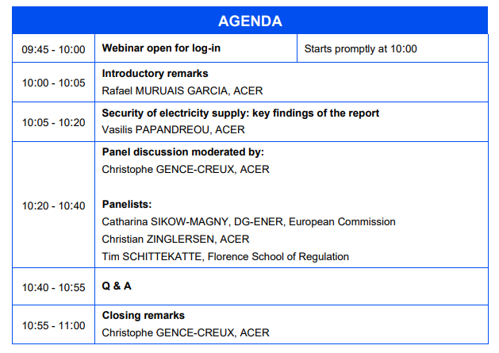
Agenda

Slide 3





Housekeeping rules
Questions shall be posed using the Slido tool within Microsoft Teams
Use direct link: https://app.sli.do/event/9fdnGgbj23rdYLe1rtzHDt
Questions from other participants can be ‘liked’ to increase their visibility
Keep your microphone muted unless the chair gives you the floor
Substance-related questions will be addressed during the relevant Q&A session; although they can be posed at any point
Slides from this webinar will be uploaded to ACER website

Slide 4
Introductory remarks
Rafael MURUAIS GARCIA

Slide 5
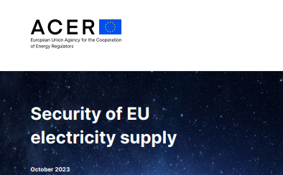
A three-fold role for the SOS monitoring task
SOS monitoring task
Inform on developments on SoS
Assist policy making
Monitor implementation

Slide 6
SOS Monitoring report 2023 Key messages
Vasilis PAPANDREOU

Slide 7
Key findings from the energy crisis
The common European framework and integrated market were essential to shelter Member States against the risks of the energy crisis
  sector interconnectivity key in overcoming uncertain gas supplies and increased outages
  multi-level coordination essential for secure supply of electricity
Any emergency necessarily calls for trade-offs and compromises; yet some approaches outperform others.
  Some measures come with adverse effects (e.g. affordability measures hinder demand reduction)
  no-regret measures, (e.g. energy efficiency, RES) should be prioritised
Recommendations:
    Accelerate and strengthen the integration of the European electricity market.
    Further reinforce inter-institutional and cross-border cooperation in security of supply.
    Prepare well-balanced and coordinated emergency measures sufficiently in advance, prioritising measures that contribute to the decarbonisation objectives.

Slide 8
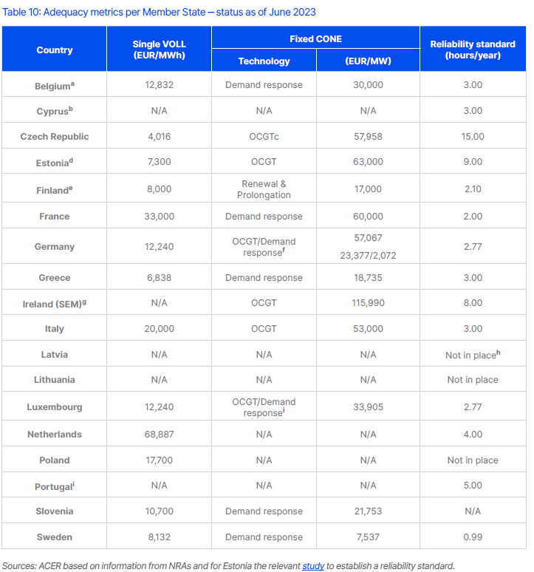
Implementation of the adequacy framework varies; some Member States are lagging behind
Ten Member States have calculated the reliability standard according to the framework – yet in a non-uniform manner.
Ireland and Poland (already with capacity mechanisms) have not set a reliability standard yet.
Level of implementation of the common European methodology (ERAA) in national assessments varies across Member States.
Not as per methodology
Recommendations:
    Ireland and Poland should appropriately set the reliability standard as soon as possible.
    Member States relying on national adequacy assessments for their capacity mechanisms should ensure that such assessments are based on the ERAA methodology.

Slide 9
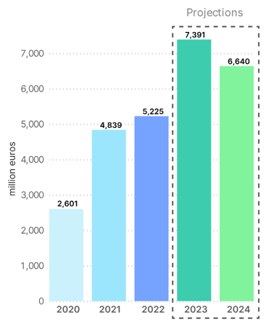
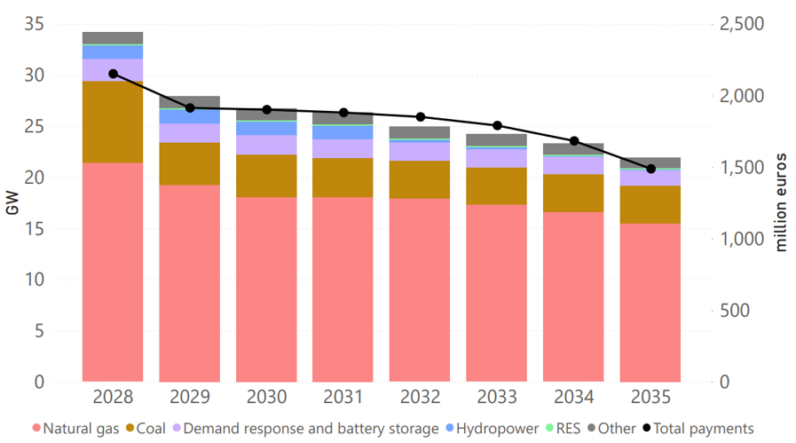
The costs of capacity mechanisms keep rising largely supporting fossil fuel power plants
Total cost of capacity mechanisms in the EU
Long term commitments of capacity mechanisms
without T-1 auctions
+40%
2Χ
Source: ACER based on information from NRAs
  Recommendation: Member States should analyse the risk of locking-in dependence on high-carbon technologies, potentially hindering the transition to a low-carbon economy.
Source: ACER based on information from NRAs

Slide 10
Design of capacity mechanisms matters
Cross border resources still largely unable to participate in national capacity mechanisms; where implemented, scope to improve rules to enable competition on equal footing.
Existing penalty regimes in capacity mechanisms often do not provide adequate incentives to guarantee delivery of the contracted service.
  Recommendations:
  National authorities should
  implement direct cross border participation as soon as possible, ensuring domestic and other EU providers compete on an equal footing.
    monitor closely cross border participation and identify any necessary adjustments.
    ensure that the penalties applied incentivise providers to commission the contracted capacity in a timely manner and be available when needed.

Slide 11
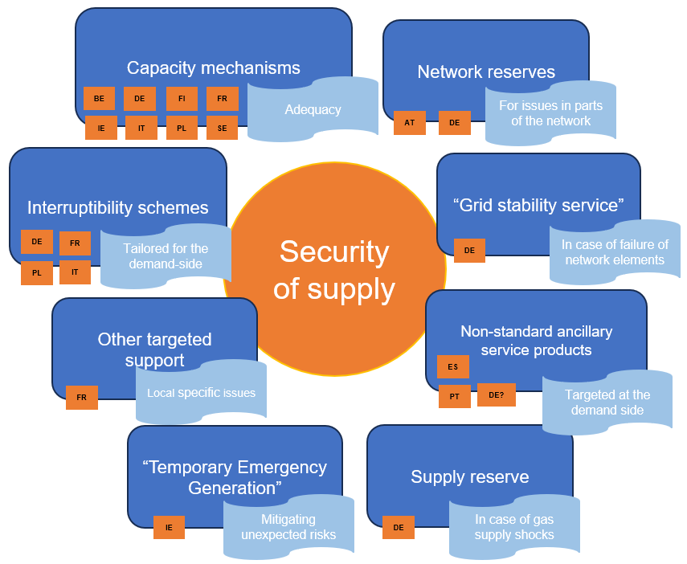
Streamlining the framework for introducing security of supply measures is necessary
To tackle security of supply risks, Member States are increasingly implementing a variety of measures often outside the adequacy framework
Uncoordinated measures, risks fragmenting the internal electricity market.
Examples of measures in place to cope with various security of supply risks (non-exhaustive)
  Recommendations:
  Streamline the process for approving capacity mechanisms and assess adequacy.
  Need to examine the adequacy and risk preparedness frameworks holistically and explore synergies between them.
  Measures targeting adequacy should not be set outside the adequacy framework; any other available measure, should be considered when assessing adequacy risks.

Slide 12
Panel discussion
Moderator: Christophe GENCE-CREUX, ACER
Panellists: Catharina SIKOW-MAGNY, DG-ENER, European Commission
Christian ZINGLERSEN, ACER
Tim SCHITTEKATTE, Florence School or Regulation

Slide 13

Q&A session
Connect to Slido
Directly in MS Teams
Through www.slido.com #ACERwebinar
Scan QR code
Use direct link: https://app.sli.do/event/9fdnGgbj23rdYLe1rtzHDt

Slide 14
Closing remarks
Christophe GENCE-CREUX, ACER

